Slide 1

IT2413
Web Programming
Week 7 Server side programming
PHP Scripting Language
MySQL Database
Apache Server

Slide 2
PHP $_GET Function
The built-in $_GET function is used to collect values from a form sent with method="get".
Information sent from a form with the GET method is visible to everyone (it will be displayed in the browser's address bar) and has limits on the amount of information to send (max. 100 characters).

Slide 3
When to use method="get"?
When using method="get" in HTML forms, all variable names and values are displayed in the URL.
Note: This method should not be used when sending passwords or other sensitive information!
However, because the variables are displayed in the URL, it is possible to bookmark the page. This can be useful in some cases.
Note: The get method is not suitable for large variable values; the value cannot exceed 100 characters.

Slide 4
PHP $_POST Function
The built-in $_POST function is used to collect values from a form sent with method="post".
Information sent from a form with the POST method is invisible to others and has no limits on the amount of information to send.
Note: However, there is an 8 Mb max size for the POST method, by default (can be changed by setting the post_max_size in the php.ini file).

Slide 5
When to use method="post"?
Information sent from a form with the POST method is invisible to others and has no limits on the amount of information to send.
However, because the variables are not displayed in the URL, it is not possible to bookmark the page.

Slide 6
PHP $_REQUEST Function
The PHP built-in $_REQUEST function contains the contents of both $_GET, $_POST, and $_COOKIE.
The $_REQUEST function can be used to collect form data sent with both the GET and POST methods.

Slide 7
$_REQUEST Function example
Welcome <?php echo $_REQUEST["fname"];
?>! <br />
You are <?php echo $_REQUEST["age"];
?> years old.

Slide 8
PHP Forms and User Inputs
In PHP form handling the most important thing is when dealing with HTML forms and PHP is that any form element in a HTML page will automatically be available to your PHP scripts.
The PHP $_GET and $_POST variables are used to retrieve information from forms, like user input.

Slide 9
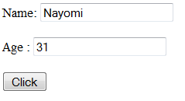

Form handling –Example1

Slide 10
Welcome.html
The example below contains an HTML form with two input fields and a submit button.
<html>
<body>
<form action="welcome.php" method="post">
//two input fields.
Name: <input type="text" name="fname" />
Age: <input type="text" name="age" />
//submit button.
<input type="submit“ value="Click" />
</form>
</body>
</html>

Slide 11
Welcome.php
<html>
<body>
Welcome <?php echo $_POST["fname"]; ?>!<br />
You are <?php echo $_POST["age"]; ?> years old.
</body>
</html>

Slide 12
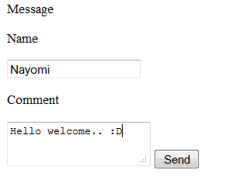

Form handling -Example 2

Slide 13
Message.html
<html>
<head>Message</head>
<body>
<form method="POST" action="reply.php">
<p> Name </p> <input type="text" name="name" size=20 />
<p> Comment </p> <textarea name="msg" ></textarea>
<input type="submit" name="send" value="Send" />
</form>
</body>
</html>

Slide 14
Reply.php
<?php
echo "<h1> Welcome:".$_POST['name']."</h1>";
echo "<p> <em> Thank you for your comment </em>: <br/>". $_POST['msg']."</p>";
?>

Slide 15
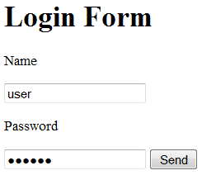

Form handling -Example 3

Slide 16
login.html
<html>
<head><title>login form</title></head>
<body>
<h1>Login Form</h1>
<form method="POST" action="login.php">
<p> Name </p> <input type="text" name="name" value="" size=20 />
<p> Password </p> <input type="password" name="pass" value="" size=20 />
<input type="submit" name="login" value="Send" />
</form>
</body>
</html>

Slide 17
Login.php
<?php
if(($_POST['name']=="user") && ($_POST['pass']=="nayomi"))
echo "<p> Hello".$_POST['name']."</p>";
else
echo "<h2> Access Denied </h2>";
?>

Slide 18


Form handling -Example 4

Slide 19
chksub.html
<html>
<head><title>Select Your Subject Combination</title></head>
<body>
<h1>Select Your Subject Combination</h1>
<form method="POST" action="chksub.php">
<p><input type="checkbox" name=subject[] value="COM" checked /><label> Computer Science</label><br/>
<input type="checkbox" name=subject[] value="MATH" /><label> Mathematics</label></br>
<input type="checkbox" name=subject[] value="CHE" /><label> Chemistry</label></br>
<input type="checkbox" name=subject[] value="BIO" /><label> Biology</label></br>
<input type="submit" name="submit" value="submit" /></p>
</form>
</body>
</html>

Slide 20
chksub.php
<?php
echo "<h1> Your Subject Combination is:</h1>";
if(!empty($_POST['subject']))
{
foreach($_POST['subject'] as $s){
echo "$s<br/>";
}}
else
{
echo "<h1> Select at least one</h1>";
}
?>

Slide 21


Form handling -Example 5

Slide 22
lstsub.html
<html>
<head><title>Select Your Subject Combination</title></head>
<body>
<h1>Select Your Subject Combination</h1>
<form method="POST" action="lstsub.php">
<select name="subject[]" multiple>
<option value="Computer science"> Computer Science</option>
<option value="Mathematics"> Mathematics</option>
<option value="Statistics"> Statistics</option>
<option value="Biology"> Biology</option>
<input type="submit" name="submit" value="submit" /></p>
</form>
</body>
</html>

Slide 23
lstsub.php
<?php
echo "<h1> Your Subject combination is:</h1>";
if(!empty($_POST['subject']))
{
foreach($_POST['subject'] as $sub)
{
echo "$sub<br/>";
}}
else
{
echo "<h2> select atleast one </h1>";
}
?>

Slide 24

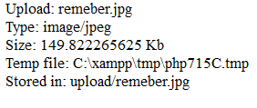
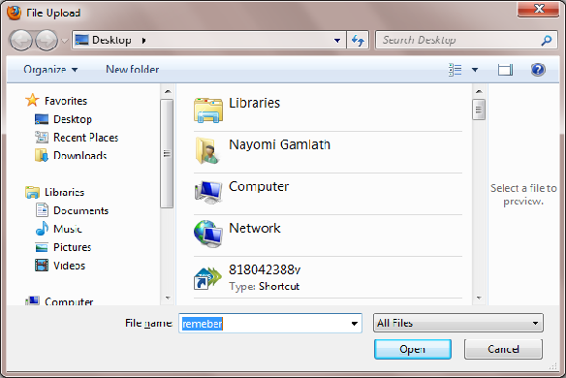
File uploading

Slide 25
Upload.html
<html>
<body>
<form action="upload_file.php" method="post"
enctype="multipart/form-data">
<label for="file">Filename:</label>
<input type="file" name="file" id="file" />
<br />
<input type="submit" name="submit" value="Submit" />
</form>
</body>
</html>
Notes:
Notice the following about the HTML form above:
The enctype attribute of the <form> tag specifies which content-type to use when submitting the form. "multipart/form-data" is used when a form requires binary data, like the contents of a file, to be uploaded
The type="file" attribute of the <input> tag specifies that the input should be processed as a file. For example, when viewed in a browser, there will be a browse-button next to the input field
Note: Allowing users to upload files is a big security risk. Only permit trusted users to perform file uploads.

Slide 26
Upload_file.php
<?php
$allowedExts = array("jpg", "jpeg", "gif", "png");
$extension = end(explode(".", $_FILES["file"]["name"]));
if ((($_FILES["file"]["type"] == "image/gif")
|| ($_FILES["file"]["type"] == "image/jpeg")
|| ($_FILES["file"]["type"] == "image/pjpeg"))
&& ($_FILES["file"]["size"] < 200000)
&& in_array($extension, $allowedExts))
{
if ($_FILES["file"]["error"] > 0)
{ echo "Return Code: " . $_FILES["file"]["error"] . "<br />";
}
else
{ echo "Upload: " . $_FILES["file"]["name"] . "<br />";
echo "Type: " . $_FILES["file"]["type"] . "<br />";
echo "Size: " . ($_FILES["file"]["size"] / 1024) . " Kb<br />";
echo "Temp file: " . $_FILES["file"]["tmp_name"] . "<br />";

Slide 27
Upload_file.php contd.
if (file_exists("upload/" . $_FILES["file"]["name"]))
{
echo $_FILES["file"]["name"] . " already exists. ";
}
else
{
move_uploaded_file($_FILES["file"]["tmp_name"],
"upload/" . $_FILES["file"]["name"]);
echo "Stored in: " . "upload/" . $_FILES["file"]["name"];
}
}
}
else
{
echo "Invalid file";
}
?>
Notes:
By using the global PHP $_FILES array you can upload files from a client computer to the remote server.
The first parameter is the form's input name and the second index can be either "name", "type", "size", "tmp_name" or "error". Like this:
$_FILES["file"]["name"] - the name of the uploaded file
$_FILES["file"]["type"] - the type of the uploaded file
$_FILES["file"]["size"] - the size in bytes of the uploaded file
$_FILES["file"]["tmp_name"] - the name of the temporary copy of the file stored on the server
$_FILES["file"]["error"] - the error code resulting from the file upload
This is a very simple way of uploading files. For security reasons, you should add restrictions on what the user is allowed to upload.
Restrictions on Upload
In this script we add some restrictions to the file upload. The user may only upload .gif or .jpeg files and the file size must be under 20 kb
Saving the Uploaded File
The examples above create a temporary copy of the uploaded files in the PHP temp folder on the server.
The temporary copied files disappears when the script ends. To store the uploaded file we need to copy it to a different location:
The script above checks if the file already exists, if it does not, it copies the file to the specified folder.
Note: This example saves the file to a new folder called "upload"

Slide 28
Working with files & Directory
Include()
  Statements enables you to cooperate other files. (usually other PHP files)
  <?php
  Include(“fun.php”);
  ?>
fun.php
<?php
Echo “Good after noon”;
?>

Slide 29
Working with files & Directory
Validating file- file_exists()
<?php
If(file_exists(“mark.txt”)) {
echo “The file can locate”;
}
else
{
echo “Can’t locate”;
}
?>

Slide 30
Working with files & Directory
Is_file – make sure is a file
<?php
If(is_file (“mark.txt”)) {
echo “The file can locate”;
}
else
{
echo “Can’t locate”;
}
?>

Slide 31
Working with files & Directory
is_dir()
is_readable()
is_writable()
filesize

Slide 32
Working with files & Directory
<?php
If(is_file(“mark.txt)
{
echo filesize(“marks.txt);
}
else
echo “file is not found”;
?>

Slide 33
Creating a file –touch()
Given a string represent a file path, touch() function attempts to create and empty file of that name. if the files is already exists it’s contain will not be changed but the modification date will be updated.
    <?php
    touch(“test.txt”)
    ?>

Slide 34
Deleting a file- unlink()
You can remove an existing file with unlink()
    <?php
    unlink(“test.txt”)
    ?>

Slide 35
Opening a file for writing reading or appending and closing
Reading
$fo=fopen(“test.txt”,”r”);
Writing
$fo=fopen(“test.txt”,”w”);
Appending
$fo=fopen(“test.txt”,”a”);
Closing
fclose($fo);

Slide 36
Reading data from a file
fgets()
fgets() function read file until it reaches newline character(“\n”) and number of bytes specified in the length argument or the end of the file which ever come first.
fgets($fo,1000);
feof()
feof() function return through when the end of the file has been read and false other types.

Slide 37
Example
<?php
$f="mark.txt";
$fo=fopen($f,"r") or die("couldn’t open");
while(!feof($fo)){
$line=fgets($fo,1000);
echo "$line<br/>";
}
fclose($fo);
?>

Slide 38
Writing your files –fwrite()
<?php
$f=“mark.txt”;
$fo=fopen($f,”w”) or die(“Couldn’t open $f”);
Fwrite($fo,”PHP writing…”);
Fclose($fo);
$fo=fopen($f,”a”) or die (“Couldn’t open $f”);
Fwrite($fo,”PHP World…”);
Fclose($fo);
?>

Slide 39
Homework
Write a program to show the number of visitors access your site.

Slide 40
Answer
<?php
if(fopen("visitor.txt","r"))
{
$con=fopen("visitor.txt","r");
while(!feof($con))
{
$line=fgets($con,5);
}
$line=$line+1;
$con=fopen("visitor.txt","w");
fwrite($con,$line);
echo "This site is accessed by $line Visitors";
fclose($con);
}
?>

Slide 41
END.

